Slide 1


OTT-PLATFORM
CHAITANYA BHARATHI INSTITUTE OF TECHNOLOGY
P RAJESHWAR REDDY (160118735039)
Under the supervision of:
ARAVIND
Exposys Data labs

Slide 2
Contents:
Abstract
Introduction
System Architecture
System Requirements
Implementation
Conclusion
References

Slide 3
Abstract: -
Today we are going through a period of lock-down which the people of India have never seen before, for such a long time. In such a situation, in the era of this technology and the Internet, anyone likes to spend their free time in front of the digital screen, where they have many options to see. The ever-increasing viewership of the OTT video streaming services and the big star's inclination towards this platform justifies this. Today, the time we spent looking at our screens has increased immensely. As the cinema halls shut and film release has been suspended amid nationwide, this technological shift by internet has created a new kind of viewing experience and that might end up changing the collective movie watching experience in cinema hall.

Slide 4
Introduction: -
By most definitions known today, OTT simply refers to any video streaming service delivering content to the users over the internet. Originally, this happened alongside (or usually on top of) a traditional platform like cable TV, hence ‘over the top’. An example here is HBO Go, which in many countries was only offered as a bonus for HBO cable subscribers. This restriction no longer exists today.
OTT could also refer to the subscription model whereby the platform (e.g. Netflix) charges the fees on top of what you’d have to pay to your ISP or cable provider… Or allows you to avoid the fees of the operator (i.e. WhatsApp is a great example here, giving its subscribers the convenience of “free” “SMS” service using their internet connection. This definition would make WhatsApp an OTT platform).
While OTT is commonly used to denote video content, many audio services fit this definition just as well. Spotify is to music what Netflix is to TV – offering a massive trove of music via the internet connection.

Slide 5
System Architecture: -
MOVIE BREAK SYSTEM
Signup
Login
New User Authentication
Subscription
Payment
Gateway
Movies Homepage
Movies
TV Series
Trending
Hollywood
Tollywood
Bollywood
Trending
New Releases
series
Top Animes

Slide 6
System Requirements: -
Hardware Requirements:
Hard Disk - 1TB
RAM – 8GB
Processor – Core i5
Software Requirements:
Operating System - Windows 10-64bit
Markup language - HTML5
Language – CSS3
Framework – Bootstrap5

Slide 7
Implementation: -
Modules:
User Module
Home Page
User Login:
The user module allows users to register, log in, and log out. Users benefit from being able to sign on because this associates content they create with their account and allows various permissions to be set for their roles. The user module supports user roles, which can be set up with fine-grained permissions allowing each role to do only what the administrator permits. Each user is assigned one or more roles. By default there are three roles: anonymous (a user who has not logged in) and authenticated (a user who is registered), and administrator (a signed in user who will be assigned site administrator permissions). Users can use their own name or handle and can fine tune some personal configuration settings through their individual my account page. Registered users need to authenticate by supplying their username and password, or alternately an OpenID login. A visitor accessing your website is assigned a unique ID, the so-called session ID, which is stored in a cookie. For security's sake, the cookie does not contain personal information but acts as a key to retrieving the information stored on your server.

Slide 8
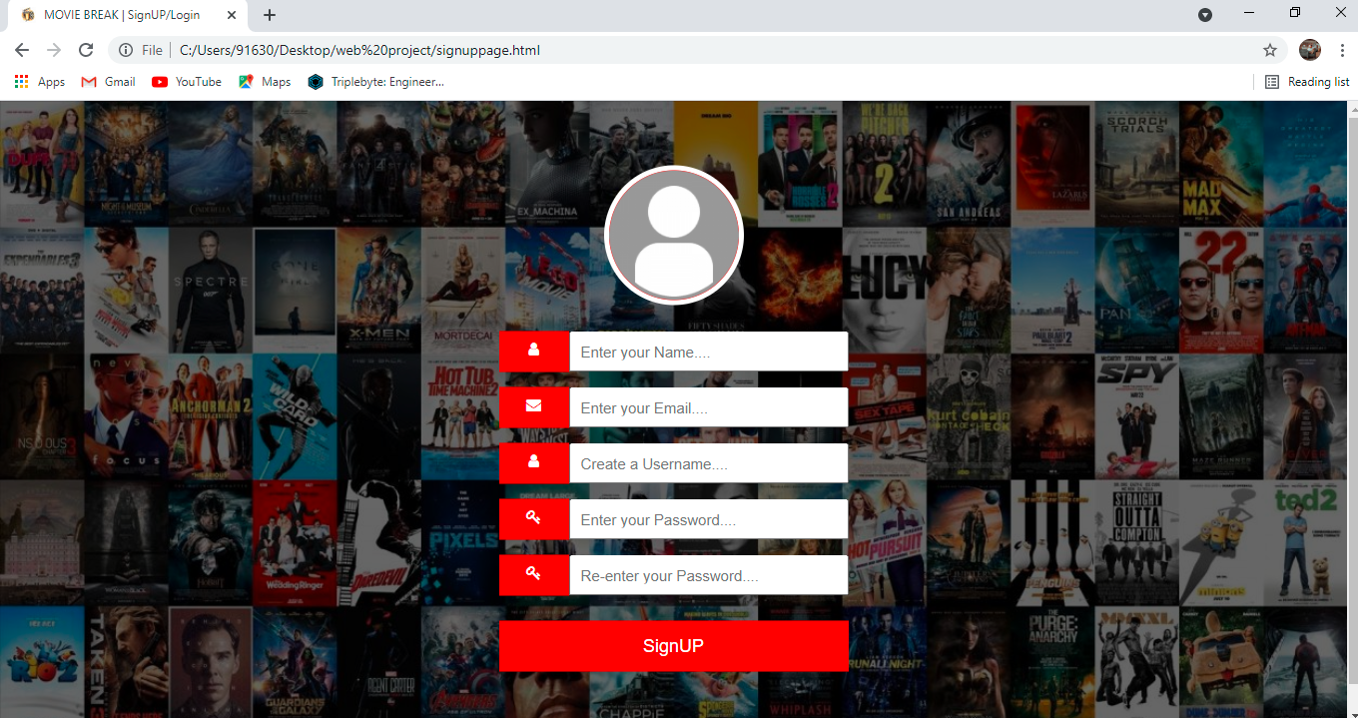
Signup Page: -
This screen will help user to generate new Username according to their wish and user will also create new password and same will be confirmed again. User will enter captcha for verification and will click on submit button to final submit. This Snapshot 1: Signup page screen will also help user to create password that is defined in the system. Password policy will also display side by side.
Snapshot-1: Signup Page

Slide 9
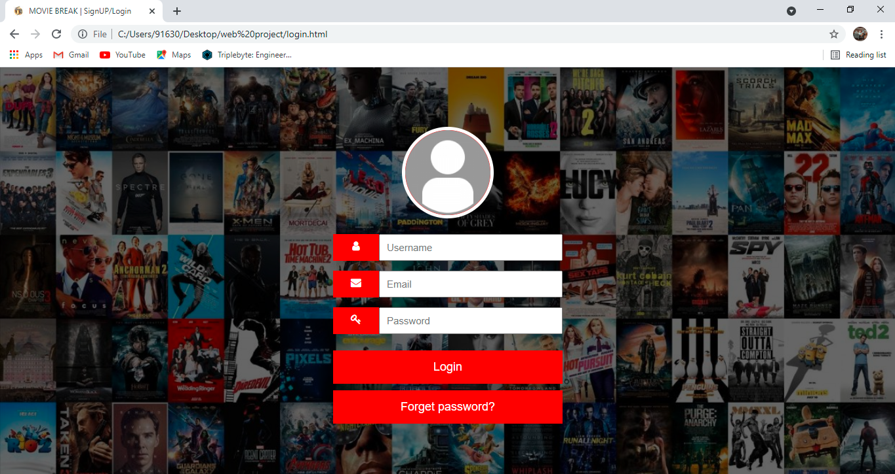
Login Page: -
He Login Module is a portal module that allows users to type a username and password to log in. You can add this module on any module tab to allow users to log in to the system. If you allow users to create accounts and turn on Portal Direct Entry, a Create Account link appears in the Login Module.
Snapshot-2: Login Page

Slide 10
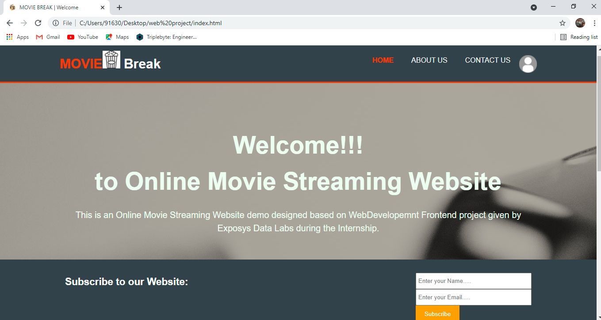
Home Page:-
A home page is generally the primary web page a visitor navigating to a website from a search engine will see, and it may also serve as a landing page to attract visitors. Thus good home page design is usually a high priority for a website. Here we are having different modules were we are going to explore over homepage.
Snapshot-3: Homepage

Slide 11
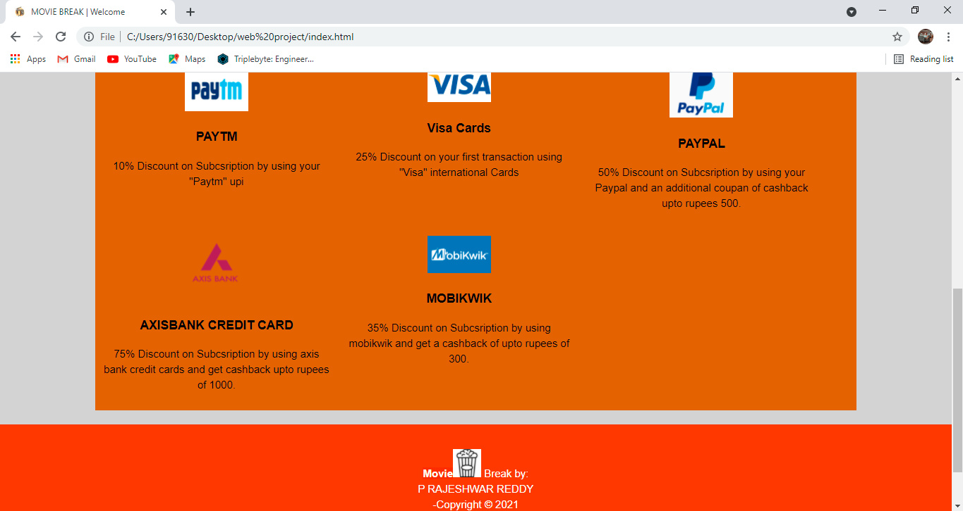
Snapshot-4: Homepage continuation
Even the home pages are having long scroll effects and it has more effects to engage users. The advantage of not having to click “next” keeps users engaged with the content and less focused on the mechanics of navigating to the next page. Snapshot 4: Homepage Continuation It translates well to mobile devices. The increased use of mobile screens has played a key role in the widespread acceptance of this technique: The smaller the screen, the longer the scroll. The gesture controls of mobile devices make scrolling intuitive and fun.

Slide 12
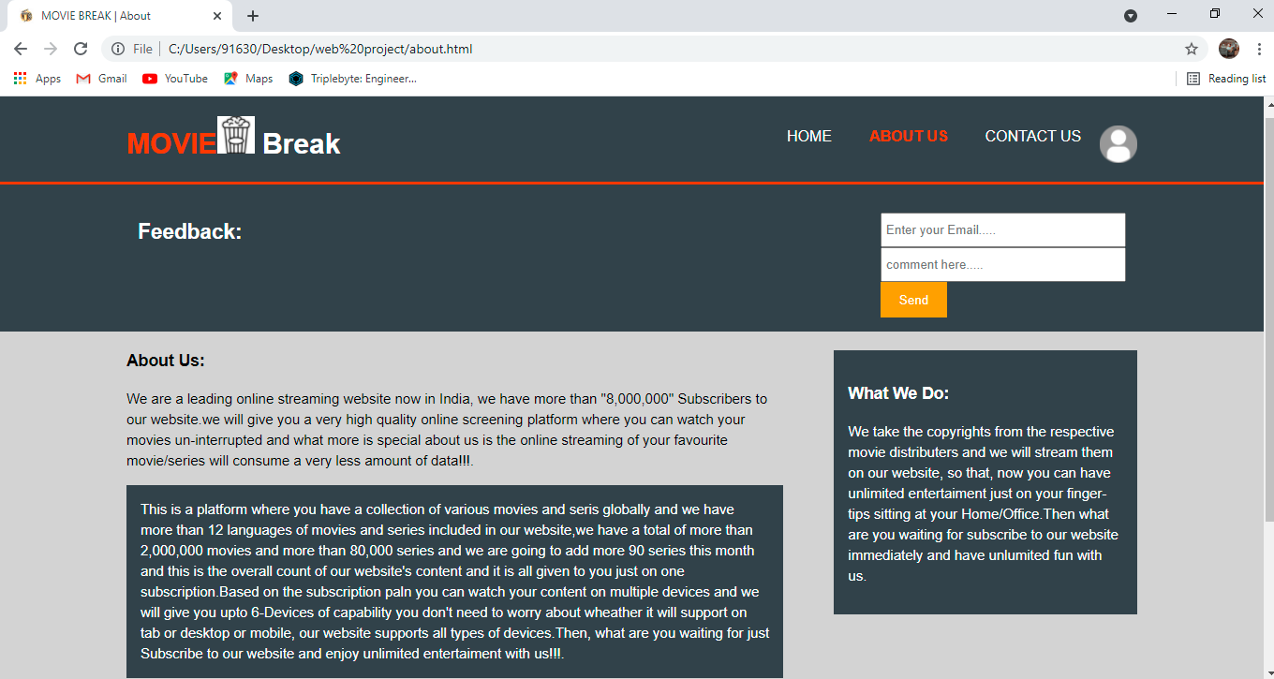
About Us: -
An About Us page may be a deciding factor before you convince someone to convert, whether that comes in the form of:
Making a purchase.
Downloading an awesome piece of content.
Signing up for your newsletter.
Requesting information or a demo
Snapshot-5: About Us Page

Slide 13
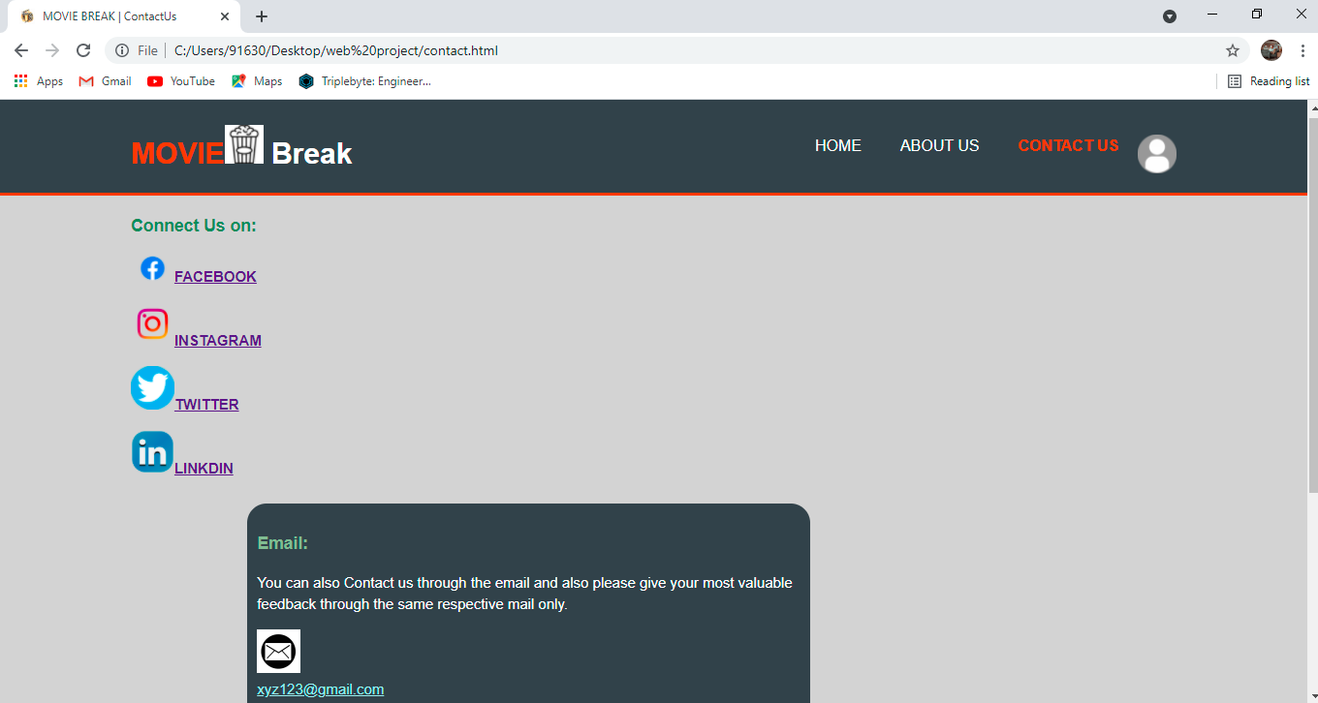
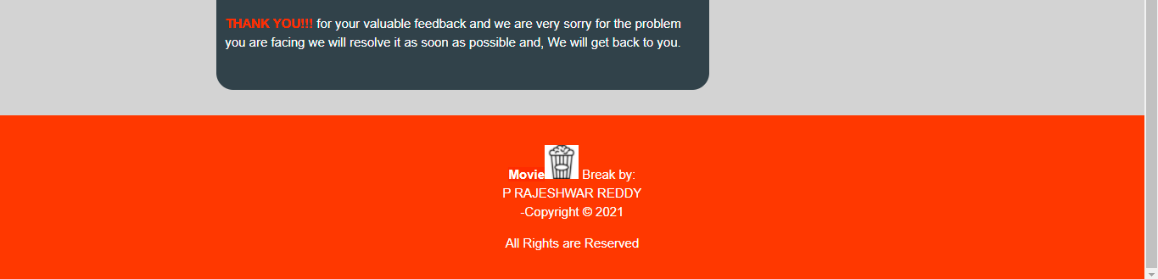
Contact Us:-
They explain why a visitor should contact you and describe how you can help to solve your visitors' problems. They include an email and phone number so that the visitors could quickly find the required information. They include a short form that uses fill that will help you understand who's contacting you.
Snapshot-6: Contact Us Page

Slide 14
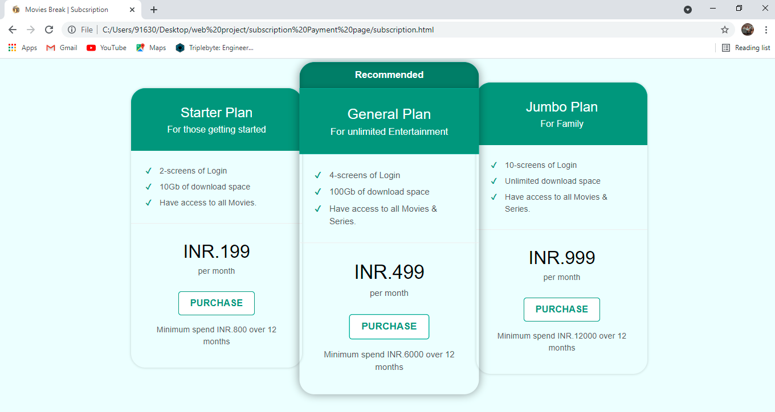
Subscription: -
A subscribe page usually consists of a short form that a visitor to your website can fill out to subscribe themselves to one or more of your lists. But here we have included the packages cost where a customer can select any of the given packages as per his/her need.
Snapshot-7: Subscription Page

Slide 15
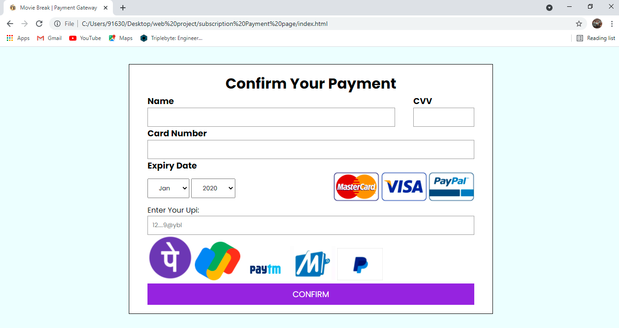
Payment Page:-
The payment page is a web page that allows customers to purchase items easily and securely. ... The payment pages involve the data about the holder of the account i. e. first and last name, email along with phone number, and card number along with the expiration period.
Snapshot-8: Payment Page

Slide 16
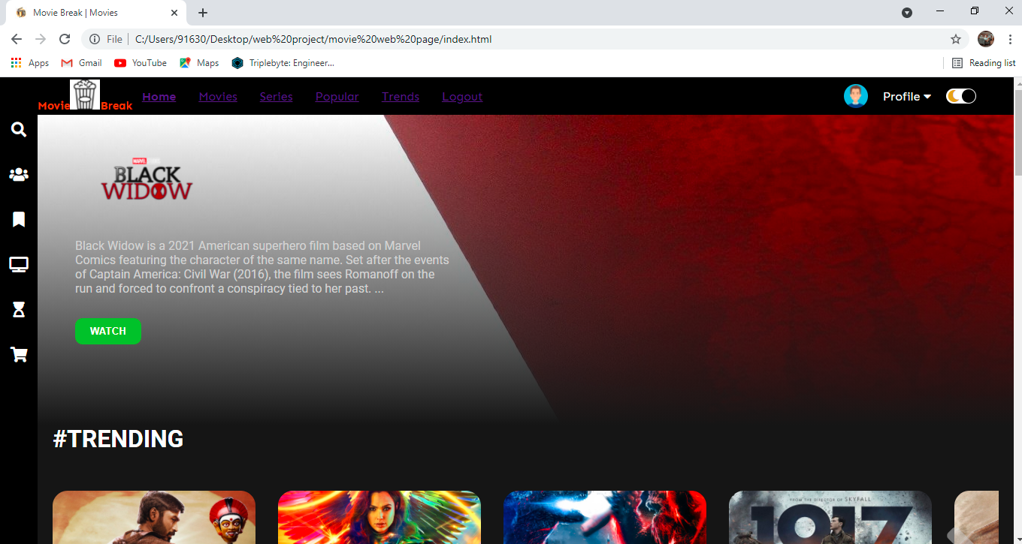
Movies: -
Movies are made to entertain audiences, and movie websites are much the same. In order to get visitors’ attention and encourage them to see the movie, a website needs to give them what they are looking for and provide some entertainment at the same time. Today’s movie websites make it easy to take a couple minutes and watch a few trailers before deciding which movie to see.
Modes Of screen:
*Dark Mode:
Snapshot-9(a): Dark Mode

Slide 17
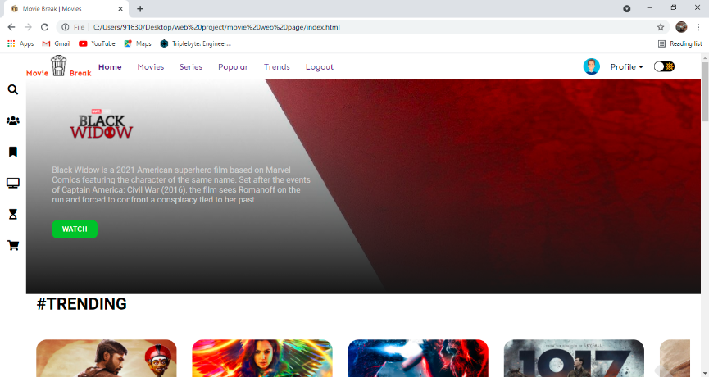
*Light Mode
Snapshot-9(b): Light Mode

Slide 18
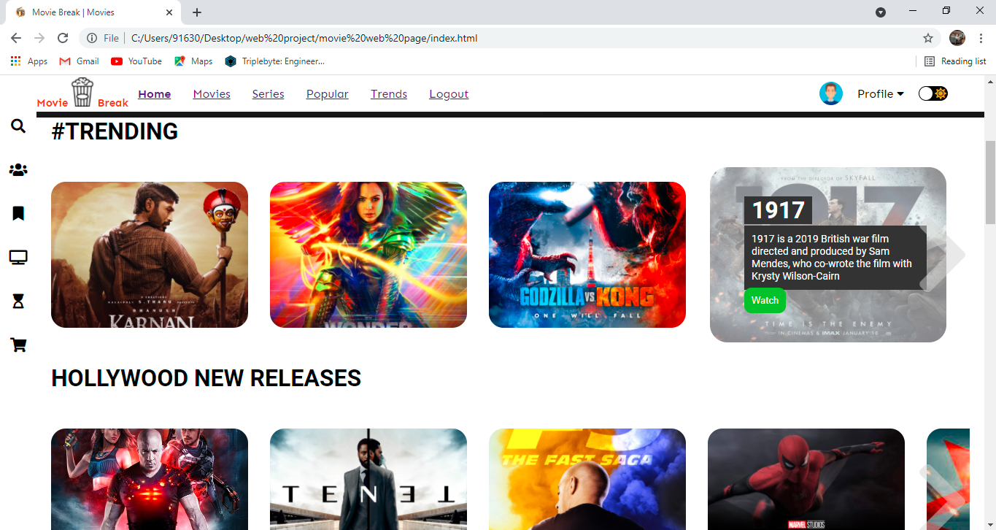
In the movie page when we place cursor on the particular movie poster we get a small description of the movie and the we can also see the watch button as shown below in the snapschot-9.
Snapshot-9(c): movies poster Hovering& description

Slide 19
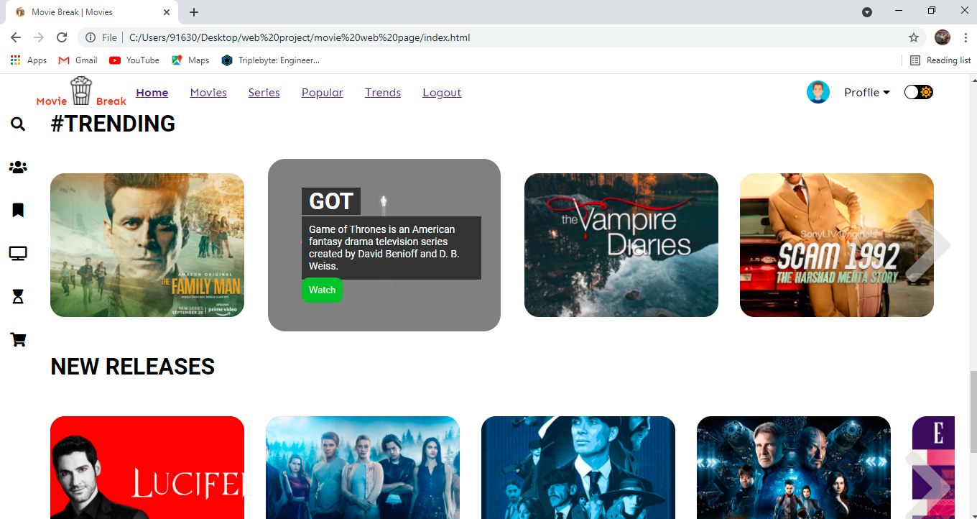
TV-series:
Snapshot-10: Tv-series

Slide 20
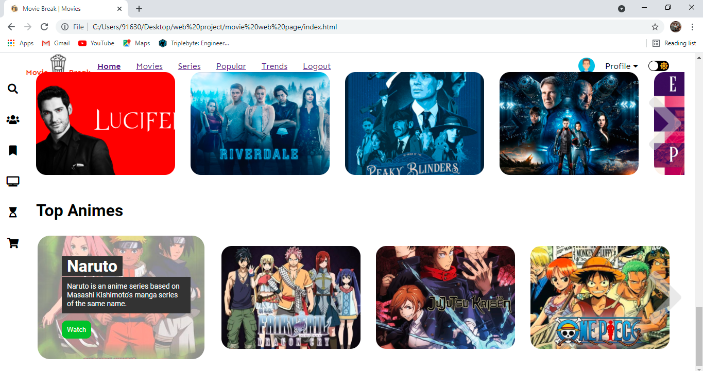
Top-Anime:
Snapshot-11: Top Anime

Slide 21
Conclusion: -
Online movie streaming is the growing business in India and due to the lockdown & corona effect in India as the theatres are closed because of the mass public gatherings have been prohibited by the government as per corona regulations so, lot of people started using the OTT apps for their personal entertainment.

Slide 22
References: -
https://www.uscreen.tv/?via=adam-enfroy
https://setplex.com/en/?utm_source=adamenfroy&utm_medium=referral&utm_campaign=bestOTTplatform
https://www.ibm.com/watson/media/ott-video-management-platform-and-services
https://www.netflix.com/in/

Slide 23
Thank You

